Slide 1
Presentstion-01
Course Title: Data Structure and Algorithms-II Lab
Course Code: CSE 2202
Our Topics: Splay Tree Deletion
Group Members:
1. Nowrin Molla(202122104004) 2. Sazid Mahmud Emon Khan(202122104005) 3. Mst. Tanima Akter(202122104011) 4. Md. Ehasan Mahmud (202122104026) 5. Meherab Hossen Opi (202122104028) 6. Saki Al Muiz Dhruvo (202122104030)

Slide 2
Splay Tree
What is splay tree?
Splay tree is a self-adjusting binary search tree. Splaying means rearranges all the elements in the root of the tree.
Rotation in splay tree:
1. Zig Rotation (Single Right Rotation) 2. Zag Rotation (Single Left Rotation) 3. Zig-Zig Rotation (Move two position to Right) 4. Zag-Zag Rotation (Move two position to Left) 5. Zig-Zag Rotation (one position to Right then left) 6. Zag-Zig Rotation (one position Left then Right)

Slide 3
A given Splay Tree:
12
10
13
14
7
16
15
17
Delete: 16, 12, 7

Slide 4
Delete: 16
We have to take 16 as root by using required rotation.
12
10
13
Left Rotate of 13
14
7
16
15
17

Slide 5
Delete: 16
We have to take 16 as root by using required rotation.
12
10
14
One Zag Rotation of 14
16
7
13
15
17

Slide 6
Delete: 16
We have to take 16 as root by using required rotation.
12
One Zag Rotation of root 12.
10
16
17
7
14
13
15

Slide 7
Delete: 16
The Root is 16. Now, We can delete 16.
Delete 16. Here 15 is the max value of left sub tree. So we have to add 15 as root of the left sub tree by using required rotation.
16
12
17
Left sub tree:
12
One Zag rotation of 12
10
14
10
14
7
13
15
7
13
15

Slide 8
Left sub tree:
(After one zag rotation of 12.)
Now, we have to do One Zag rotation of 14
15
14
14
12
15
After zag rotation of 14, now left sub tree’s max value are in the root of left sub tree.
12
10
13
10
13
7
7
Now, we have to add a join operation with right sub tree.

Slide 9
The final Splay Tree after delete 16:
15
14
17
12
10
13
7

Slide 10
Delete 12:
14
15
12
15
14
17
10
13
17
12
7
10
13
7
12
10
14
7
15
13
17

Slide 11
Final Splay Tree after delete 12:
10
7
14
13
15
17

Slide 12
Delete 7:
7
10
10
7
14
14
13
15
13
15
17
17

Slide 13
After Deletion of 7 the final Tree:
10
14
13
15
17

Slide 14
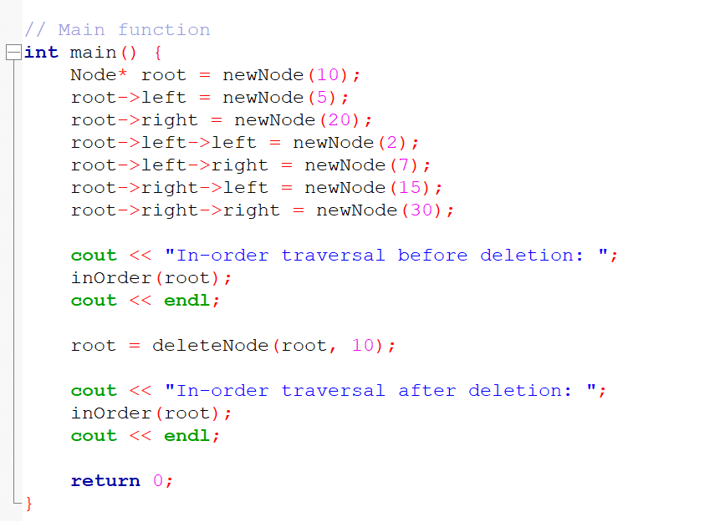
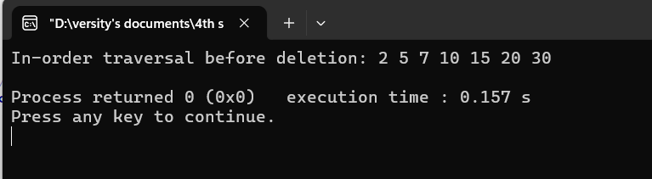
Code:

Slide 15
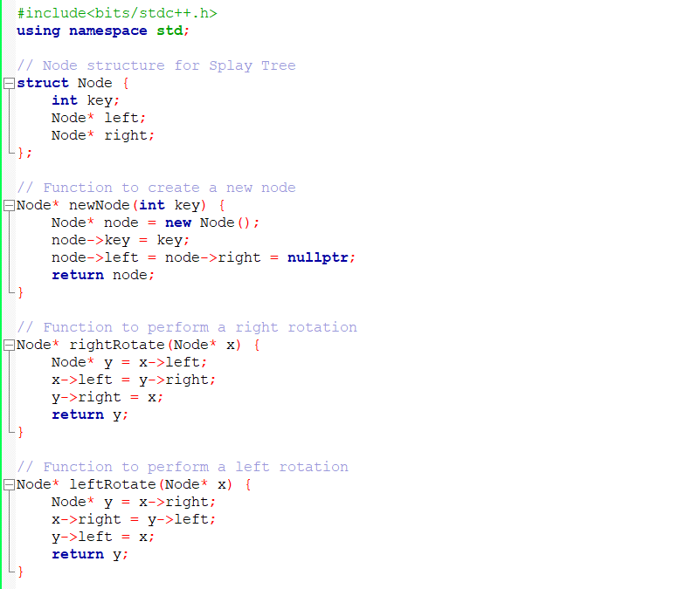

Slide 16
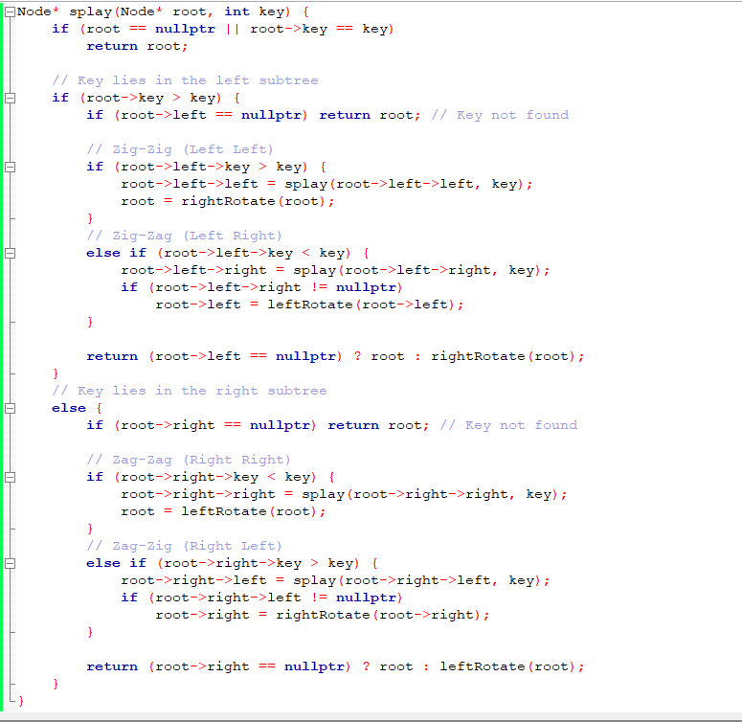

Slide 17
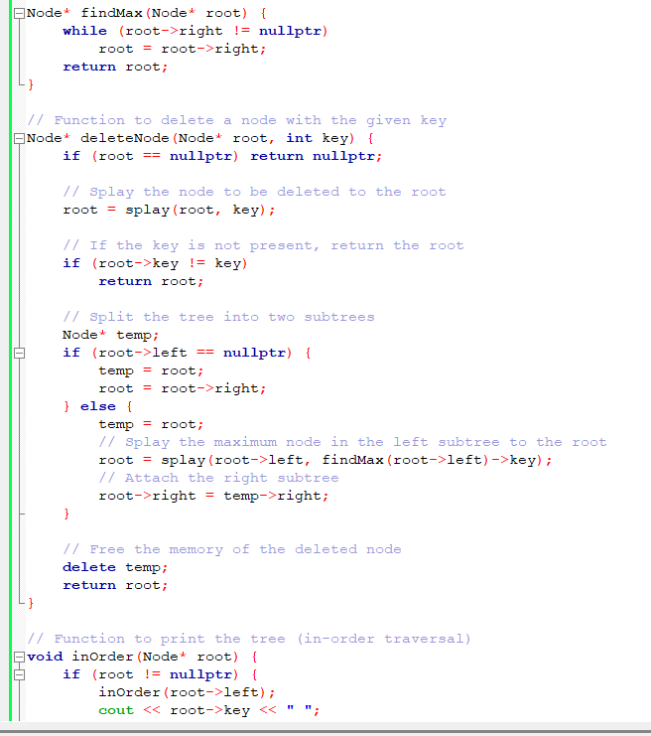

Slide 18
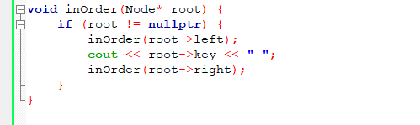
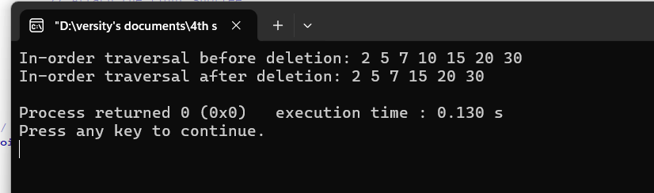
Output:

Slide 19
Thank You

